Slide 1
KFNEDS:SP

Slide 2
Main Objectives
Identify the processes and practices used by employers to increase the employment of people with disabilities and their effectiveness.
Collect qualitative information on specific practices and challenges.
Further examine the upper management commitment, which is identified as quite important in prior studies.
2
Notes:
Respondents were screened out if they currently have no direct supervisees
We asked both demo & employment characteristics (e.g., gender, age, years with org, years as supervisor, state in which employed)
Within each topic covered we asked
Whether the organization has a formal or established process,
How committed upper management is – and how important it is to the supervisors - to include people with disabilities in practices related to each topic area,
We presented 1 to 3 specific practices and asked whether the organization engages in these practices. If so, we asked them how effective they thought each practice was; if not, we asked them if it would be feasible to adopt the practices in order to facilitate employment for people with disabilities;
Finally, we asked several open-ended questions along the way to solicit more information. The survey culminates in two open-ended questions: “Please briefly share a [negative / positive] experience you had or a [difficulty you faced / success] related to supervising people with disabilities”

Slide 3
Description
3,085 supervisors from across the country
Drawn from Qualtrics Business-to-Business panel
Subject areas:
  Recruiting & hiring, Onboarding & training, Retention & accommodation
Within each subject area:
  Processes and practices and their effectiveness
  Supervisor’s and upper management commitment
  Open-ended question to obtain examples
3
Notes:
Respondents were screened out if they currently have no direct supervisees
We asked both demo & employment characteristics (e.g., gender, age, years with org, years as supervisor, state in which employed)
Within each topic covered we asked
Whether the organization has a formal or established process,
How committed upper management is – and how important it is to the supervisors - to include people with disabilities in practices related to each topic area,
We presented 1 to 3 specific practices and asked whether the organization engages in these practices. If so, we asked them how effective they thought each practice was; if not, we asked them if it would be feasible to adopt the practices in order to facilitate employment for people with disabilities;
Finally, we asked several open-ended questions along the way to solicit more information. The survey culminates in two open-ended questions: “Please briefly share a [negative / positive] experience you had or a [difficulty you faced / success] related to supervising people with disabilities”

Slide 4
Demographics of Respondents
 | # | %
Male | 1,265 | 41
Female | 1,820 | 59
White | 2,375 | 77
Non-white | 1,018 | 33
18 – 34 | 833 | 27
35 – 54 | 1,481 | 48
55 + | 740 | 24
< College | 740 | 24
College + | 2,345 | 76
4
Notes:
Respondents were screened out if they currently have no direct supervisees
We asked both demo & employment characteristics (e.g., gender, age, years with org, years as supervisor, state in which employed)
Within each topic covered we asked
Whether the organization has a formal or established process,
How committed upper management is – and how important it is to the supervisors - to include people with disabilities in practices related to each topic area,
We presented 1 to 3 specific practices and asked whether the organization engages in these practices. If so, we asked them how effective they thought each practice was; if not, we asked them if it would be feasible to adopt the practices in order to facilitate employment for people with disabilities;
Finally, we asked several open-ended questions along the way to solicit more information. The survey culminates in two open-ended questions: “Please briefly share a [negative / positive] experience you had or a [difficulty you faced / success] related to supervising people with disabilities”

Slide 5
Own/Family Experience with Disability
 | %
Any experience | 45
- Own | 18
- Someone close | 39
- Hearing | 14
- Vision | 6
- Ambulatory | 18
- Cognitive | 21
No experience | 55
5
Notes:
Respondents were screened out if they currently have no direct supervisees
We asked both demo & employment characteristics (e.g., gender, age, years with org, years as supervisor, state in which employed)
Within each topic covered we asked
Whether the organization has a formal or established process,
How committed upper management is – and how important it is to the supervisors - to include people with disabilities in practices related to each topic area,
We presented 1 to 3 specific practices and asked whether the organization engages in these practices. If so, we asked them how effective they thought each practice was; if not, we asked them if it would be feasible to adopt the practices in order to facilitate employment for people with disabilities;
Finally, we asked several open-ended questions along the way to solicit more information. The survey culminates in two open-ended questions: “Please briefly share a [negative / positive] experience you had or a [difficulty you faced / success] related to supervising people with disabilities”

Slide 6
Company Size (Number of Employees)
 | # | %
25 – 99 | 692 | 22.4
100 – 499 | 910 | 29.5
500 – 999 | 401 | 13.0
1,000 + | 1,082 | 35.1
6
Notes:
Respondents were screened out if they currently have no direct supervisees
We asked both demo & employment characteristics (e.g., gender, age, years with org, years as supervisor, state in which employed)
Within each topic covered we asked
Whether the organization has a formal or established process,
How committed upper management is – and how important it is to the supervisors - to include people with disabilities in practices related to each topic area,
We presented 1 to 3 specific practices and asked whether the organization engages in these practices. If so, we asked them how effective they thought each practice was; if not, we asked them if it would be feasible to adopt the practices in order to facilitate employment for people with disabilities;
Finally, we asked several open-ended questions along the way to solicit more information. The survey culminates in two open-ended questions: “Please briefly share a [negative / positive] experience you had or a [difficulty you faced / success] related to supervising people with disabilities”

Slide 7
Supervisory Experience of Respondents
How long at employer
Years | %
1 to 5 | 32
6 to 10 | 29
11 to 20 | 24
21 or more | 15
How long supervising
Years | %
1 or fewer | 13
2 to 5 | 40
6 to 10 | 21
11 or more | 26
How many supervised
Number | %
1 to 5 | 36
6 to 10 | 23
11 to 20 | 19
21 or more | 22
7
Notes:
Respondents were screened out if they currently have no direct supervisees
We asked both demo & employment characteristics (e.g., gender, age, years with org, years as supervisor, state in which employed)
Within each topic covered we asked
Whether the organization has a formal or established process,
How committed upper management is – and how important it is to the supervisors - to include people with disabilities in practices related to each topic area,
We presented 1 to 3 specific practices and asked whether the organization engages in these practices. If so, we asked them how effective they thought each practice was; if not, we asked them if it would be feasible to adopt the practices in order to facilitate employment for people with disabilities;
Finally, we asked several open-ended questions along the way to solicit more information. The survey culminates in two open-ended questions: “Please briefly share a [negative / positive] experience you had or a [difficulty you faced / success] related to supervising people with disabilities”

Slide 8
Experience Hiring People with Disabilities
# Hired | % | % Hired any People w/ Disabilities | Avg. # People w/ Disabilities
None | 10 | - | -
1 to 5 | 28 | 29 | 0.5
6 to 10 | 16 | 55 | 1.4
11 to 20 | 14 | 70 | 3.1
21 to 50 | 13 | 76 | 5.4
> 50 | 19 | 80 | 12.8
Total | 100 | 58 | 4.3
8
Notes:
Respondents were screened out if they currently have no direct supervisees
We asked both demo & employment characteristics (e.g., gender, age, years with org, years as supervisor, state in which employed)
Within each topic covered we asked
Whether the organization has a formal or established process,
How committed upper management is – and how important it is to the supervisors - to include people with disabilities in practices related to each topic area,
We presented 1 to 3 specific practices and asked whether the organization engages in these practices. If so, we asked them how effective they thought each practice was; if not, we asked them if it would be feasible to adopt the practices in order to facilitate employment for people with disabilities;
Finally, we asked several open-ended questions along the way to solicit more information. The survey culminates in two open-ended questions: “Please briefly share a [negative / positive] experience you had or a [difficulty you faced / success] related to supervising people with disabilities”

Slide 9
Experience Supervising People with Disabilities
 | %
Experience | 51
Hearing | 20
- Vision | 9
- Mobility | 26
- Cognitive | 27
Not experience | 49
9
Notes:
Respondents were screened out if they currently have no direct supervisees
We asked both demo & employment characteristics (e.g., gender, age, years with org, years as supervisor, state in which employed)
Within each topic covered we asked
Whether the organization has a formal or established process,
How committed upper management is – and how important it is to the supervisors - to include people with disabilities in practices related to each topic area,
We presented 1 to 3 specific practices and asked whether the organization engages in these practices. If so, we asked them how effective they thought each practice was; if not, we asked them if it would be feasible to adopt the practices in order to facilitate employment for people with disabilities;
Finally, we asked several open-ended questions along the way to solicit more information. The survey culminates in two open-ended questions: “Please briefly share a [negative / positive] experience you had or a [difficulty you faced / success] related to supervising people with disabilities”

Slide 10
Commitment of Upper Management and
Importance to Supervisor
10
Notes:
Respondents were screened out if they currently have no direct supervisees
We asked both demo & employment characteristics (e.g., gender, age, years with org, years as supervisor, state in which employed)
Within each topic covered we asked
Whether the organization has a formal or established process,
How committed upper management is – and how important it is to the supervisors - to include people with disabilities in practices related to each topic area,
We presented 1 to 3 specific practices and asked whether the organization engages in these practices. If so, we asked them how effective they thought each practice was; if not, we asked them if it would be feasible to adopt the practices in order to facilitate employment for people with disabilities;
Finally, we asked several open-ended questions along the way to solicit more information. The survey culminates in two open-ended questions: “Please briefly share a [negative / positive] experience you had or a [difficulty you faced / success] related to supervising people with disabilities”

Slide 11
Supporting PwD Learning the Job
Very
Somewhat
Not very
Not at all
Upper management commitment
Importance to supervisor
11
Notes:
Respondents were screened out if they currently have no direct supervisees
We asked both demo & employment characteristics (e.g., gender, age, years with org, years as supervisor, state in which employed)
Within each topic covered we asked
Whether the organization has a formal or established process,
How committed upper management is – and how important it is to the supervisors - to include people with disabilities in practices related to each topic area,
We presented 1 to 3 specific practices and asked whether the organization engages in these practices. If so, we asked them how effective they thought each practice was; if not, we asked them if it would be feasible to adopt the practices in order to facilitate employment for people with disabilities;
Finally, we asked several open-ended questions along the way to solicit more information. The survey culminates in two open-ended questions: “Please briefly share a [negative / positive] experience you had or a [difficulty you faced / success] related to supervising people with disabilities”

Slide 12
Providing Requested Accommodations
Very
Somewhat
Not very
Not at all
Upper management commitment
Importance to supervisor
12
Notes:
Respondents were screened out if they currently have no direct supervisees
We asked both demo & employment characteristics (e.g., gender, age, years with org, years as supervisor, state in which employed)
Within each topic covered we asked
Whether the organization has a formal or established process,
How committed upper management is – and how important it is to the supervisors - to include people with disabilities in practices related to each topic area,
We presented 1 to 3 specific practices and asked whether the organization engages in these practices. If so, we asked them how effective they thought each practice was; if not, we asked them if it would be feasible to adopt the practices in order to facilitate employment for people with disabilities;
Finally, we asked several open-ended questions along the way to solicit more information. The survey culminates in two open-ended questions: “Please briefly share a [negative / positive] experience you had or a [difficulty you faced / success] related to supervising people with disabilities”

Slide 13
Organizational Processes
- Has process?
- Effective?
- As effective for people
with disabilities?
13
Notes:
Respondents were screened out if they currently have no direct supervisees
We asked both demo & employment characteristics (e.g., gender, age, years with org, years as supervisor, state in which employed)
Within each topic covered we asked
Whether the organization has a formal or established process,
How committed upper management is – and how important it is to the supervisors - to include people with disabilities in practices related to each topic area,
We presented 1 to 3 specific practices and asked whether the organization engages in these practices. If so, we asked them how effective they thought each practice was; if not, we asked them if it would be feasible to adopt the practices in order to facilitate employment for people with disabilities;
Finally, we asked several open-ended questions along the way to solicit more information. The survey culminates in two open-ended questions: “Please briefly share a [negative / positive] experience you had or a [difficulty you faced / success] related to supervising people with disabilities”

Slide 14
Recruiting Process
14
Notes:
Respondents were screened out if they currently have no direct supervisees
We asked both demo & employment characteristics (e.g., gender, age, years with org, years as supervisor, state in which employed)
Within each topic covered we asked
Whether the organization has a formal or established process,
How committed upper management is – and how important it is to the supervisors - to include people with disabilities in practices related to each topic area,
We presented 1 to 3 specific practices and asked whether the organization engages in these practices. If so, we asked them how effective they thought each practice was; if not, we asked them if it would be feasible to adopt the practices in order to facilitate employment for people with disabilities;
Finally, we asked several open-ended questions along the way to solicit more information. The survey culminates in two open-ended questions: “Please briefly share a [negative / positive] experience you had or a [difficulty you faced / success] related to supervising people with disabilities”

Slide 15
Organizational Hiring Goals
15
Notes:
Respondents were screened out if they currently have no direct supervisees
We asked both demo & employment characteristics (e.g., gender, age, years with org, years as supervisor, state in which employed)
Within each topic covered we asked
Whether the organization has a formal or established process,
How committed upper management is – and how important it is to the supervisors - to include people with disabilities in practices related to each topic area,
We presented 1 to 3 specific practices and asked whether the organization engages in these practices. If so, we asked them how effective they thought each practice was; if not, we asked them if it would be feasible to adopt the practices in order to facilitate employment for people with disabilities;
Finally, we asked several open-ended questions along the way to solicit more information. The survey culminates in two open-ended questions: “Please briefly share a [negative / positive] experience you had or a [difficulty you faced / success] related to supervising people with disabilities”

Slide 16
“Moderate” to “A Lot” of Effort
Spent on Recruiting
16
Notes:
Respondents were screened out if they currently have no direct supervisees
We asked both demo & employment characteristics (e.g., gender, age, years with org, years as supervisor, state in which employed)
Within each topic covered we asked
Whether the organization has a formal or established process,
How committed upper management is – and how important it is to the supervisors - to include people with disabilities in practices related to each topic area,
We presented 1 to 3 specific practices and asked whether the organization engages in these practices. If so, we asked them how effective they thought each practice was; if not, we asked them if it would be feasible to adopt the practices in order to facilitate employment for people with disabilities;
Finally, we asked several open-ended questions along the way to solicit more information. The survey culminates in two open-ended questions: “Please briefly share a [negative / positive] experience you had or a [difficulty you faced / success] related to supervising people with disabilities”

Slide 17
Process: Supporting New Employees Learn Job
17
Notes:
Respondents were screened out if they currently have no direct supervisees
We asked both demo & employment characteristics (e.g., gender, age, years with org, years as supervisor, state in which employed)
Within each topic covered we asked
Whether the organization has a formal or established process,
How committed upper management is – and how important it is to the supervisors - to include people with disabilities in practices related to each topic area,
We presented 1 to 3 specific practices and asked whether the organization engages in these practices. If so, we asked them how effective they thought each practice was; if not, we asked them if it would be feasible to adopt the practices in order to facilitate employment for people with disabilities;
Finally, we asked several open-ended questions along the way to solicit more information. The survey culminates in two open-ended questions: “Please briefly share a [negative / positive] experience you had or a [difficulty you faced / success] related to supervising people with disabilities”

Slide 18
Process: Request Accommodations
18
Notes:
Respondents were screened out if they currently have no direct supervisees
We asked both demo & employment characteristics (e.g., gender, age, years with org, years as supervisor, state in which employed)
Within each topic covered we asked
Whether the organization has a formal or established process,
How committed upper management is – and how important it is to the supervisors - to include people with disabilities in practices related to each topic area,
We presented 1 to 3 specific practices and asked whether the organization engages in these practices. If so, we asked them how effective they thought each practice was; if not, we asked them if it would be feasible to adopt the practices in order to facilitate employment for people with disabilities;
Finally, we asked several open-ended questions along the way to solicit more information. The survey culminates in two open-ended questions: “Please briefly share a [negative / positive] experience you had or a [difficulty you faced / success] related to supervising people with disabilities”

Slide 19
Centralized Accommodation Fund
19
Notes:
Respondents were screened out if they currently have no direct supervisees
We asked both demo & employment characteristics (e.g., gender, age, years with org, years as supervisor, state in which employed)
Within each topic covered we asked
Whether the organization has a formal or established process,
How committed upper management is – and how important it is to the supervisors - to include people with disabilities in practices related to each topic area,
We presented 1 to 3 specific practices and asked whether the organization engages in these practices. If so, we asked them how effective they thought each practice was; if not, we asked them if it would be feasible to adopt the practices in order to facilitate employment for people with disabilities;
Finally, we asked several open-ended questions along the way to solicit more information. The survey culminates in two open-ended questions: “Please briefly share a [negative / positive] experience you had or a [difficulty you faced / success] related to supervising people with disabilities”

Slide 20
Specific Practices
20
Notes:
Respondents were screened out if they currently have no direct supervisees
We asked both demo & employment characteristics (e.g., gender, age, years with org, years as supervisor, state in which employed)
Within each topic covered we asked
Whether the organization has a formal or established process,
How committed upper management is – and how important it is to the supervisors - to include people with disabilities in practices related to each topic area,
We presented 1 to 3 specific practices and asked whether the organization engages in these practices. If so, we asked them how effective they thought each practice was; if not, we asked them if it would be feasible to adopt the practices in order to facilitate employment for people with disabilities;
Finally, we asked several open-ended questions along the way to solicit more information. The survey culminates in two open-ended questions: “Please briefly share a [negative / positive] experience you had or a [difficulty you faced / success] related to supervising people with disabilities”

Slide 21
Recruiting: Partner with Disability Organizations
35%
85%
Feasible?
Don’t Know
38%
Uses Practice?
Feasible?
66%
No
27%
Effective?
95%
Yes
21
Notes:
Respondents were screened out if they currently have no direct supervisees
We asked both demo & employment characteristics (e.g., gender, age, years with org, years as supervisor, state in which employed)
Within each topic covered we asked
Whether the organization has a formal or established process,
How committed upper management is – and how important it is to the supervisors - to include people with disabilities in practices related to each topic area,
We presented 1 to 3 specific practices and asked whether the organization engages in these practices. If so, we asked them how effective they thought each practice was; if not, we asked them if it would be feasible to adopt the practices in order to facilitate employment for people with disabilities;
Finally, we asked several open-ended questions along the way to solicit more information. The survey culminates in two open-ended questions: “Please briefly share a [negative / positive] experience you had or a [difficulty you faced / success] related to supervising people with disabilities”

Slide 22
Train Supervisors in Accessible Application & Interview Techniques
23%
Feasible?
83%
Don’t Know
37%
Feasible?
67%
No
Uses Practice?
40%
87%
Effective?
Yes
22
Notes:
Respondents were screened out if they currently have no direct supervisees
We asked both demo & employment characteristics (e.g., gender, age, years with org, years as supervisor, state in which employed)
Within each topic covered we asked
Whether the organization has a formal or established process,
How committed upper management is – and how important it is to the supervisors - to include people with disabilities in practices related to each topic area,
We presented 1 to 3 specific practices and asked whether the organization engages in these practices. If so, we asked them how effective they thought each practice was; if not, we asked them if it would be feasible to adopt the practices in order to facilitate employment for people with disabilities;
Finally, we asked several open-ended questions along the way to solicit more information. The survey culminates in two open-ended questions: “Please briefly share a [negative / positive] experience you had or a [difficulty you faced / success] related to supervising people with disabilities”

Slide 23
Hiring Practices: Review or Audit Hiring Procedures to Ensure Accessibility
37%
85%
Feasible?
Don’t Know
No
20%
Feasible?
Uses Practice?
64%
43%
86%
Effective?
Yes
23
Notes:
Respondents were screened out if they currently have no direct supervisees
We asked both demo & employment characteristics (e.g., gender, age, years with org, years as supervisor, state in which employed)
Within each topic covered we asked
Whether the organization has a formal or established process,
How committed upper management is – and how important it is to the supervisors - to include people with disabilities in practices related to each topic area,
We presented 1 to 3 specific practices and asked whether the organization engages in these practices. If so, we asked them how effective they thought each practice was; if not, we asked them if it would be feasible to adopt the practices in order to facilitate employment for people with disabilities;
Finally, we asked several open-ended questions along the way to solicit more information. The survey culminates in two open-ended questions: “Please briefly share a [negative / positive] experience you had or a [difficulty you faced / success] related to supervising people with disabilities”

Slide 24
Training Practices: Short-term Outside Assistance
56%
70%
No
Feasible?
Uses Practice?
25%
Effective?
82%
86%
Sometimes
As effective PWD?
Yes
19%
Effective?
89%
86%
24
Notes:
Respondents were screened out if they currently have no direct supervisees
We asked both demo & employment characteristics (e.g., gender, age, years with org, years as supervisor, state in which employed)
Within each topic covered we asked
Whether the organization has a formal or established process,
How committed upper management is – and how important it is to the supervisors - to include people with disabilities in practices related to each topic area,
We presented 1 to 3 specific practices and asked whether the organization engages in these practices. If so, we asked them how effective they thought each practice was; if not, we asked them if it would be feasible to adopt the practices in order to facilitate employment for people with disabilities;
Finally, we asked several open-ended questions along the way to solicit more information. The survey culminates in two open-ended questions: “Please briefly share a [negative / positive] experience you had or a [difficulty you faced / success] related to supervising people with disabilities”

Slide 25
Training Practices: Job Shadowing
Feasible?
No
12%
70%
27%
Effective?
93%
As effective PWD?
75%
Sometimes
61%
98%
Uses Practice?
80%
Effective?
As effective PWD?
Yes
25
Notes:
Respondents were screened out if they currently have no direct supervisees
We asked both demo & employment characteristics (e.g., gender, age, years with org, years as supervisor, state in which employed)
Within each topic covered we asked
Whether the organization has a formal or established process,
How committed upper management is – and how important it is to the supervisors - to include people with disabilities in practices related to each topic area,
We presented 1 to 3 specific practices and asked whether the organization engages in these practices. If so, we asked them how effective they thought each practice was; if not, we asked them if it would be feasible to adopt the practices in order to facilitate employment for people with disabilities;
Finally, we asked several open-ended questions along the way to solicit more information. The survey culminates in two open-ended questions: “Please briefly share a [negative / positive] experience you had or a [difficulty you faced / success] related to supervising people with disabilities”

Slide 26
Training Practices: Onsite Training by Supervisor or Coworker
No
Feasible?
5%
77%
22%
Effective?
94%
As effective PWD?
79%
Sometimes
73%
97%
81%
Uses Practice?
Effective?
As effective PWD?
Yes
26
Notes:
Respondents were screened out if they currently have no direct supervisees
We asked both demo & employment characteristics (e.g., gender, age, years with org, years as supervisor, state in which employed)
Within each topic covered we asked
Whether the organization has a formal or established process,
How committed upper management is – and how important it is to the supervisors - to include people with disabilities in practices related to each topic area,
We presented 1 to 3 specific practices and asked whether the organization engages in these practices. If so, we asked them how effective they thought each practice was; if not, we asked them if it would be feasible to adopt the practices in order to facilitate employment for people with disabilities;
Finally, we asked several open-ended questions along the way to solicit more information. The survey culminates in two open-ended questions: “Please briefly share a [negative / positive] experience you had or a [difficulty you faced / success] related to supervising people with disabilities”

Slide 27
Accommodation Practices: Job Sharing
57%
Feasible?
48%
No
Uses Practice?
30%
86%
Effective?
84%
Sometimes
As effective PWD?
Effective?
Yes
13%
95%
92%
27
Notes:
Respondents were screened out if they currently have no direct supervisees
We asked both demo & employment characteristics (e.g., gender, age, years with org, years as supervisor, state in which employed)
Within each topic covered we asked
Whether the organization has a formal or established process,
How committed upper management is – and how important it is to the supervisors - to include people with disabilities in practices related to each topic area,
We presented 1 to 3 specific practices and asked whether the organization engages in these practices. If so, we asked them how effective they thought each practice was; if not, we asked them if it would be feasible to adopt the practices in order to facilitate employment for people with disabilities;
Finally, we asked several open-ended questions along the way to solicit more information. The survey culminates in two open-ended questions: “Please briefly share a [negative / positive] experience you had or a [difficulty you faced / success] related to supervising people with disabilities”

Slide 28
Accommodation Practices: Flexible Work Schedule
23%
Feasible?
48%
No
52%
90%
79%
Uses Practice?
Effective?
As effective PWD?
Sometimes
25%
Effective?
95%
As effective PWD?
86%
Yes
28
Notes:
Respondents were screened out if they currently have no direct supervisees
We asked both demo & employment characteristics (e.g., gender, age, years with org, years as supervisor, state in which employed)
Within each topic covered we asked
Whether the organization has a formal or established process,
How committed upper management is – and how important it is to the supervisors - to include people with disabilities in practices related to each topic area,
We presented 1 to 3 specific practices and asked whether the organization engages in these practices. If so, we asked them how effective they thought each practice was; if not, we asked them if it would be feasible to adopt the practices in order to facilitate employment for people with disabilities;
Finally, we asked several open-ended questions along the way to solicit more information. The survey culminates in two open-ended questions: “Please briefly share a [negative / positive] experience you had or a [difficulty you faced / success] related to supervising people with disabilities”

Slide 29
Accommodation Practices: Work from Home (At Least Some of the Time)
45%
Feasible?
No
21%
Uses Practice?
38%
Effective?
74%
69%
Sometimes
As effective PWD?
18%
Effective?
85%
Yes
87%
29
Notes:
Respondents were screened out if they currently have no direct supervisees
We asked both demo & employment characteristics (e.g., gender, age, years with org, years as supervisor, state in which employed)
Within each topic covered we asked
Whether the organization has a formal or established process,
How committed upper management is – and how important it is to the supervisors - to include people with disabilities in practices related to each topic area,
We presented 1 to 3 specific practices and asked whether the organization engages in these practices. If so, we asked them how effective they thought each practice was; if not, we asked them if it would be feasible to adopt the practices in order to facilitate employment for people with disabilities;
Finally, we asked several open-ended questions along the way to solicit more information. The survey culminates in two open-ended questions: “Please briefly share a [negative / positive] experience you had or a [difficulty you faced / success] related to supervising people with disabilities”

Slide 30
Retention Practices: Cultural Competence Training for Employees
30%
Feasible?
80%
No
27%
85%
In the past
Uses Practice?
Effective
for retaining PWD?
43%
94%
Regularly
30
Notes:
Respondents were screened out if they currently have no direct supervisees
We asked both demo & employment characteristics (e.g., gender, age, years with org, years as supervisor, state in which employed)
Within each topic covered we asked
Whether the organization has a formal or established process,
How committed upper management is – and how important it is to the supervisors - to include people with disabilities in practices related to each topic area,
We presented 1 to 3 specific practices and asked whether the organization engages in these practices. If so, we asked them how effective they thought each practice was; if not, we asked them if it would be feasible to adopt the practices in order to facilitate employment for people with disabilities;
Finally, we asked several open-ended questions along the way to solicit more information. The survey culminates in two open-ended questions: “Please briefly share a [negative / positive] experience you had or a [difficulty you faced / success] related to supervising people with disabilities”

Slide 31
Areas of Future Analyses
Investigate difference by company size, years of experience, and other factors.
Analyze responses in relation to disability type.
Examine open-ended responses for unique practices and experiences.
Re-contact respondents with follow-up questions.
31
Notes:
Respondents were screened out if they currently have no direct supervisees
We asked both demo & employment characteristics (e.g., gender, age, years with org, years as supervisor, state in which employed)
Within each topic covered we asked
Whether the organization has a formal or established process,
How committed upper management is – and how important it is to the supervisors - to include people with disabilities in practices related to each topic area,
We presented 1 to 3 specific practices and asked whether the organization engages in these practices. If so, we asked them how effective they thought each practice was; if not, we asked them if it would be feasible to adopt the practices in order to facilitate employment for people with disabilities;
Finally, we asked several open-ended questions along the way to solicit more information. The survey culminates in two open-ended questions: “Please briefly share a [negative / positive] experience you had or a [difficulty you faced / success] related to supervising people with disabilities”

Slide 32
Findings to Improve Corporate Culture and Practices
Underutilized Effective Practices Seen as Feasible
Common Practices are Effective for Many - Universal Design
Upper Management’s Commitment is Key to Success of Employees with Disabilities and their Supervisors
32
Notes:
Respondents were screened out if they currently have no direct supervisees
We asked both demo & employment characteristics (e.g., gender, age, years with org, years as supervisor, state in which employed)
Within each topic covered we asked
Whether the organization has a formal or established process,
How committed upper management is – and how important it is to the supervisors - to include people with disabilities in practices related to each topic area,
We presented 1 to 3 specific practices and asked whether the organization engages in these practices. If so, we asked them how effective they thought each practice was; if not, we asked them if it would be feasible to adopt the practices in order to facilitate employment for people with disabilities;
Finally, we asked several open-ended questions along the way to solicit more information. The survey culminates in two open-ended questions: “Please briefly share a [negative / positive] experience you had or a [difficulty you faced / success] related to supervising people with disabilities”

Slide 33
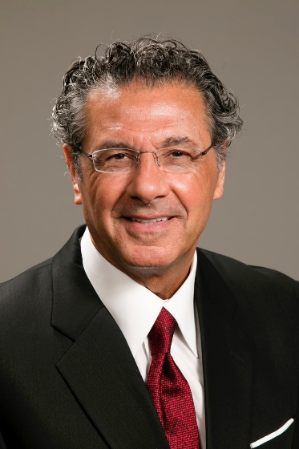
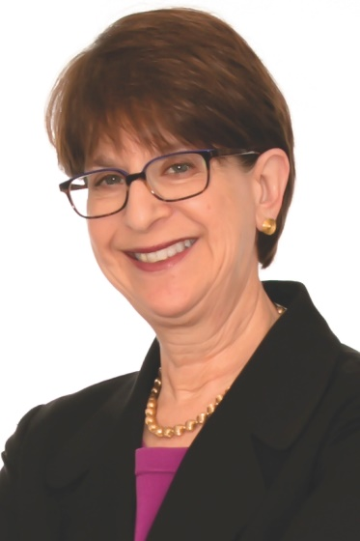
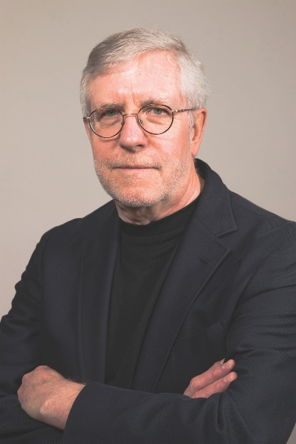
MEET OUR EXPERTS: Kessler Foundation
^{Rodger DeRose}
President & Chief Executive Officer
^{Kessler Foundation}
^{Elaine E. Katz, MS, CCC-SLP}
Senior VP for Grants and Communication
^{Kessler Foundation}
^{John O’Neill, PhD, CRC}
Director of Employment Research
^{Kessler Foundation}
33
Notes:
Respondents were screened out if they currently have no direct supervisees
We asked both demo & employment characteristics (e.g., gender, age, years with org, years as supervisor, state in which employed)
Within each topic covered we asked
Whether the organization has a formal or established process,
How committed upper management is – and how important it is to the supervisors - to include people with disabilities in practices related to each topic area,
We presented 1 to 3 specific practices and asked whether the organization engages in these practices. If so, we asked them how effective they thought each practice was; if not, we asked them if it would be feasible to adopt the practices in order to facilitate employment for people with disabilities;
Finally, we asked several open-ended questions along the way to solicit more information. The survey culminates in two open-ended questions: “Please briefly share a [negative / positive] experience you had or a [difficulty you faced / success] related to supervising people with disabilities”

Slide 34
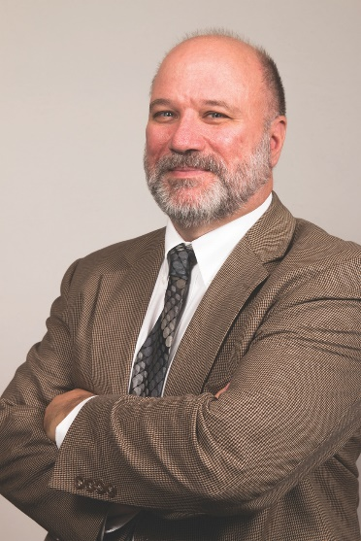
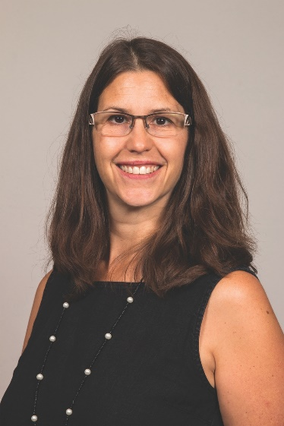
MEET OUR EXPERTS: University of New Hampshire
^{Andrew Houtenville, PhD}
^{Director of Research}
University of New Hampshire-Institute on Disability
^{Kimberly Phillips, PhD}
^{Project Director}
University of New Hampshire-Institute on Disability
34
Notes:
Respondents were screened out if they currently have no direct supervisees
We asked both demo & employment characteristics (e.g., gender, age, years with org, years as supervisor, state in which employed)
Within each topic covered we asked
Whether the organization has a formal or established process,
How committed upper management is – and how important it is to the supervisors - to include people with disabilities in practices related to each topic area,
We presented 1 to 3 specific practices and asked whether the organization engages in these practices. If so, we asked them how effective they thought each practice was; if not, we asked them if it would be feasible to adopt the practices in order to facilitate employment for people with disabilities;
Finally, we asked several open-ended questions along the way to solicit more information. The survey culminates in two open-ended questions: “Please briefly share a [negative / positive] experience you had or a [difficulty you faced / success] related to supervising people with disabilities”

